Slide 1


Future of charities & tax – getting the process right
11-12 April 2019
Nick Bland
Senior Associate
09 977 5313 | 021 241 4504b
nicholas.bland@simpsongrierson.comnd@simpsongrierson.com

Slide 2
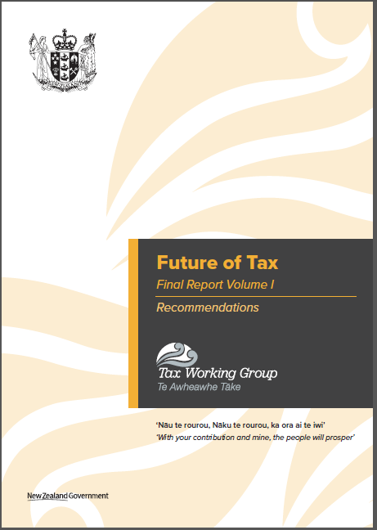

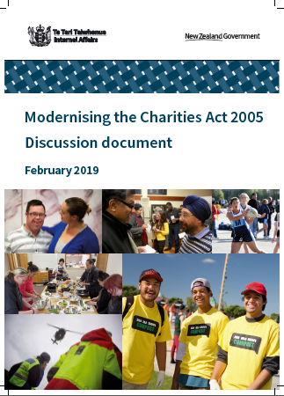
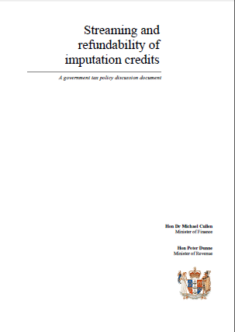
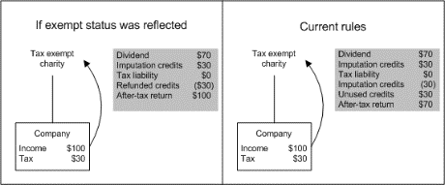
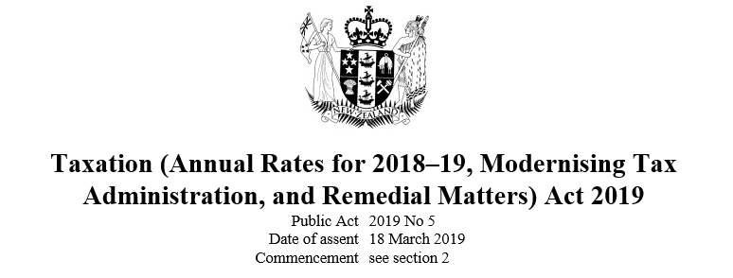
Some problems with the process
Default mindset seems to be antipathy
  The focus in relation to charity taxation is “integrity”
  Clawback/tightening of tax concessions is prioritised
IRD pushing through policy changes via…
  Re-interpretation of legislation
  ‘Remedial’ legislative changes
The Charities Act vs. charity taxation
  The Charities Act is tax legislation
  DIA vs. IRD roles
Lack of charitable sector…
  Capacity/resource
  Awareness/engagement
  Representation/submissions

Slide 3



The process could be improved by…
Adopting a more balanced mindset
  Tax concessions for charities deliver public benefit
  Enhancing/extending, not just clawing back/tightening, concessions
Improving IRD’s approach
  Care & management
  Generic tax policy process – use it
Recognising the Charities Act/charity taxation interplay
Giving the sector better/additional avenues to be heard on Charities Act/charity taxation matters
  Formalised/officially recognised advisory board or SUG arrangements?
  An NZLS Charity/NFP Committee? And what about CAANZ?
  New or improved sector-led options?

